Slide 1
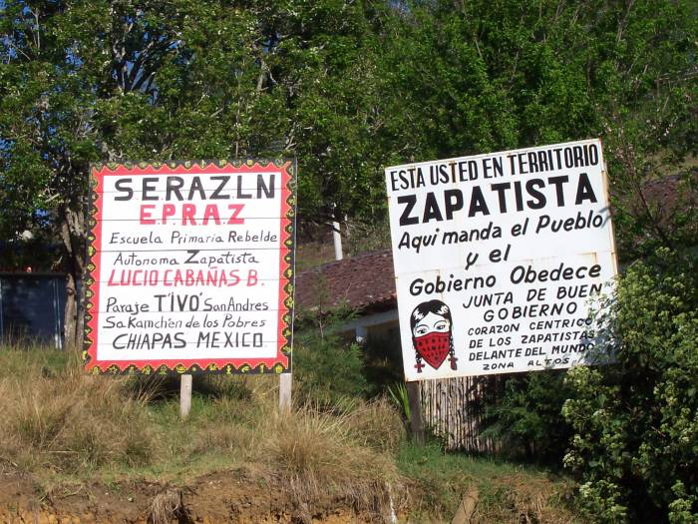
A brief overview…
“You are in the autonomous territory in rebellion of the Zapatistas. Here the people command and the government obeys.”
Slide show created by Rachael Davidson

Slide 2
January 1, 1994
The Zapatistas began their rebellion with a number of specific list of 11 demands: work, land, housing, food, health care, education, independence, freedom, democracy, justice, and peace.
The First Declaration from the Lacandon Jungle, issued on January 2, 1994, opens with the statement, "We are the product of 500 years of struggle." In addition, on that same date the Zapatistas issued a law about women's rights.
Over the last few years the demands and vision of the movement has deepened and matured. The most complete statement of their current position is available in a document known as The Sixth Declaration of the Lacandon Jungle.
(Schools for Chiapas – www.schoolsforchiapas.org)

Slide 3
Behind our black mask,
Behind our armed voice,
Behind our unnameable name,
Behind us, who you see,
Behind us, we are you.
Behind us, you are us.
Behind our masks is the face of all excluded women,
Of all the forgotten individuals,
Of all the persecuted homosexuals,
Of all the despised youth,
Of all the beaten migrants,
Of all those imprisoned for their words and thoughts,
Of all the humiliated workers,
Of all those dead from neglect,
Of all the simple and ordinary men and women,
Who don’t count,
Who aren’t seen,
Who are nameless,
Who have no tomorrow.
Notes:
Marcos

Slide 4
¿Dondé esta Chiapas? Where is Chiapas?
Chiapas located
in the most
Southeastern region
of Mexico bordering
Guatemala. Chiapas
is ecologically diverse
ranging from a 156
mile coastline,
tropical rainforest,
Sierra Madre
mountain range,
and highlands
mountainous regions
known as “Los Altos.”

Slide 6
“Poor People, Rich State”
Largest generator of hydroelectricity (55% of total production of Mexico)
Oil and Gas
156 miles of coastline
Timber
In the last 40 years Chiapas has lost 70% of its natural resources
Notes:
Add picture with houses

Slide 7
Chiapas: 73,724 square kilometers
Population 3.5 million
The population of Chiapas
constitutes three per cent of the
national population.
Languages: Mayan
Ch’ol
Lancandon
Tzeltal
Tzotzil
Tojolabal
Zoque
Mam
Kanjobal
Two Tojolabal women in traditional dress, La Realidad, Chiapas, Mexico. (Schools for Chiapas)

Slide 8
Autonomous Zapatista Zones
http://www.counterpunch.org/wp-content/dropzone/2014/01/best-map.jpg

Slide 9
La Lucha para la Tierra y la Libertad The struggle for Land and Liberty
History of 500 years of resistance in Mexico
Slavery
Invasion of Spain
North American expansion
Expelling of the French Empire
dictatorship of Porfirio Diaz (PRI)
North American Free Trade Agreement (NAFTA)

Slide 10
Emiliano Zapata
(1879 – 1919)
The Zapatista National Liberation Army took its name from Emiliano Zapata, a hero of the 1910-1917 Mexican Revolution, who fought for "Land and Liberty."
http://www.culturalsurvival.org/publications/cultural-survival-quarterly/mexico/ecology-zapatista-revolt#sthash.k7WCLObg.dpuf

Slide 11
The Two Sides of NAFTA
“Farmers in the United States, Canada, and Mexico all benefit from NAFTA.”
(fas.usda.gov)
“NAFTA is a death sentence for the indigenous people.”
Notes:
www.fas.usda.gov

Slide 12
“Whose Idea of Progress?”
NAFTA promised progress to rural farmers - how can indigenous farmers benefit if they cannot compete?
"With the highways have come the war tanks, the cannons,
soldiers, prostitution, venereal diseases, alcoholism, rapes
of indigenous women and children, death and misery."
http://www.csuchico.edu/zapatist/HTML/Archive/Communiques/marcos_amador_courage_aug.html
“Indigenous people of Mexico have never had the freedom of expression- to set price for goods – the buyer sets the price – this is where the exploitation begins.”
Notes:
Rocky soil can’t compete with rich, fertile soil of California

Slide 13
Las Personas Desplazadas The Displaced People
13,000 people estimated displaced in at least 20 municipalities in Chiapas (2003)
The indigenous population of Mexico approx. 17.8 million persons, has suffered the greatest internal displacement in Chiapas
Notes:
Human Rights organizations report in 2003

Slide 14
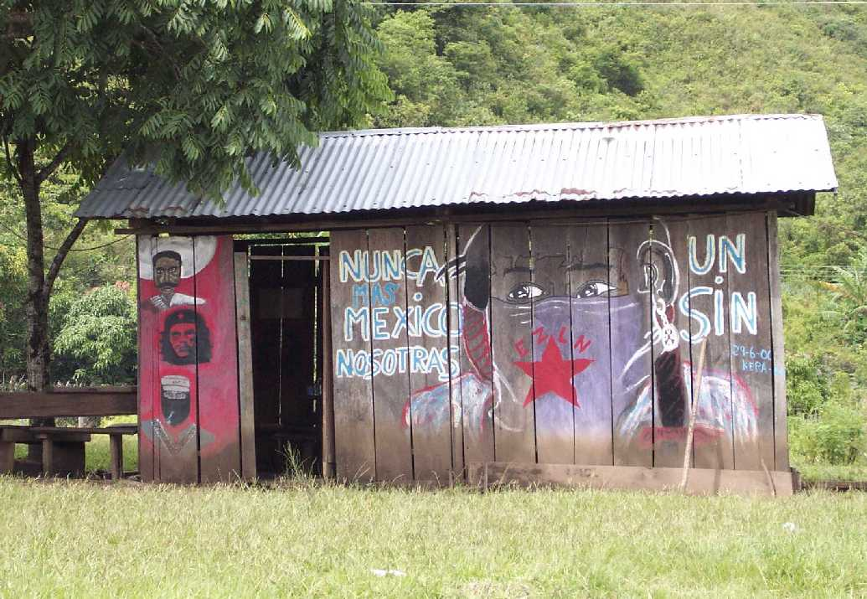
Causes of displacement
International
Displacement Project
report:
1994 Zapatista uprising
conflict between Mexican military and the EZLN
1997 Acteal massacre
ongoing harassments by paramilitary, government and armed civilians
Human rights observers
report:
paramilitary activity
armed conflict
violation of human rights
land disputes
Bottom photo by R. Davidson
Notes:
Info collected from International Displacement Worldwide Project. idpproject.org

Slide 15
Revolutionary Women’s Law Women have the right to…..
Participate in revolutionary struggle
Work and recieve a fair salary
Decide number of children to bear and care for
Hold positions of authority if freely and democratically elected
Primary to health care
Education
Choose their partner and cannot be forced to marry
not be beaten or physically mistreated by family or strangers
Occupy positions of leadership and hold military ranks
All rights and obligations elaborated in the revolutionary
laws and regulations.

Slide 16
“We do not need to change our culture, our clothing, our language, our way of prayer, our way of working and respecting the land, we cannot stop being indigenous in order to be recognized as Mexicans.”
Comandante Esther August 9, 2003
Photo by R. Davidson

Slide 17
La Resistencia – Creating Change
Civilian Zapatista Centers (Caracoles)
Autonomous Education
Health clinics
Women’s cooperatives
Collective farming

Slide 18
ZapatistaHealth Care
Provides health care to Zapatista communities
Pharmacy stocked with western medicine and natural herbs grown on site
Majority of illnesses are poverty-related and preventable through vaccination and sanitary measures

Slide 19
Education
ESRAZ – Escuela Secundaria Rebelde Autonomía Zapatista
Promotores y promotoras –education is recipricol between students and teachers -
Focus of education - preserve culture, language, & way of life
Students – often times students stay in dorms for periodsof time during year – travel long distances on foot
International Support
Notes:
Find another foto of the front of the clinica

Slide 20
Democracy Now! Report from Chiapas 20 years later (1994-2014)
http://www.youtube.com/watch?v=pTzC_QqSqwc

Slide 21
Music - Corridos
“Corridos spring from a long Mexican tradition of political and satirical music broadly diffused during the early 20th century Mexican revolution led by Emiliano Zapata. Corridos are the most revolutionary of musical styles within the contemporary Zapatista movement. This quintessential Mexican music is played at community festivals, on the ubiquitous Zapatista pirate radio stations, and within Mexican and international solidarity circles. A guitar or accordion provides the lead melody line accompanied by a bass and rhythm guitar joined with two to four part vocal harmonies. Mexican Corridos tell a story in the form of a song often celebrating key dates and individuals within the social movements. The passions of the 1994 insurrection sparked an explosion of songwriting in the corrido form that continues today ~ especially in autonomous Mayan communities.”
http://www.schoolsforchiapas.org/english/store/catalog/896.html

Slide 22
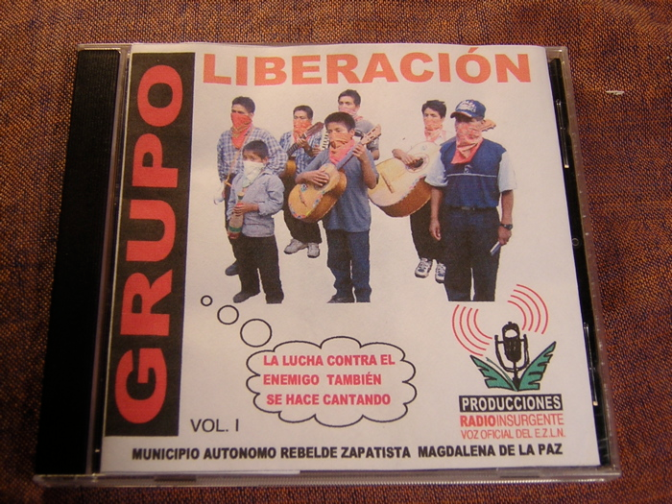
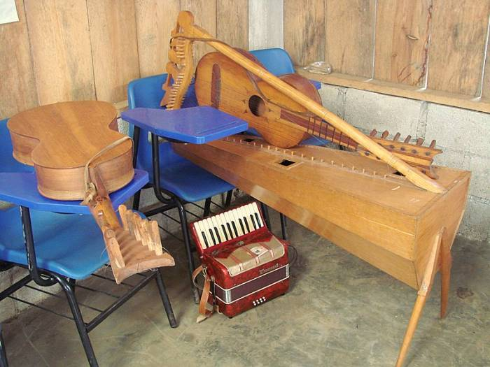
http://www.schoolsforchiapas.org/assets/catalog/902/harp_guitar.jpg

Slide 23
La Conquista por Grupo Liberación
Soy Chiapaneco
Y soy Zapatista
Tengo el orgullo
De ser de Aquí
Soy descendiente
Del pueblo Maya
Raza bendita
De mi nación
Quiero contarles
Nuestra historia
Quiero contarles
De la Nación
Lo que ha pasado
En aquellos años
Cuando vinieron
A conquistar
Los pueblos Mayas
Y su cultura
Fueron destruidos
Por la invasión
Los españoles
Conquistadores
Esclavizaron
A la nación
Tres cientos años
De ser esclavos
Cuando Hidalgo
Se levantó
Lleva los indios
A luchar
Por independencia
Y por libertad
En quinientos años
No se terminan
Esta injusticia
Y la maldad
Los pueblos Mayas
Viven injusticia
Hambre, miseria
Y enfermedad
Somos Tzotziles
Y Tojolabales
Somos Tzeltales
Y Chol también
Soy Chiapaneco
Y soy Zapatista
Tengo el orgullo
De ser de aquí
Soy descendiente
Del pueblo Maya
Raza bendita
De la nación

Slide 24
for more information / additional resources
Zapatistas
http://enlacezapatista.ezln.org.mx/
www.schoolsforchiapas.org
http://www.seattleglobaljustice.org/2014/01/nafta-zapatista-uprising-20-years/
www.mexicosolidarity.org
www.revistarebeldia.org
Corridos:
http://www.corridos.org/
With His Pistol in His Hand: A border ballad and its hero by Américo Paredes. (University of Texas Press, 1998.)
http://www.schoolsforchiapas.org/english/projects/schools-of-hope/mayan-music.html

Slide 25
Photos:
www.schoolsforchiapas.org
www.fzln.org.mx
www.ciepac.org
www.axisoflogic.com
Personal collection – R. Davidson

